Slide 1

MALLA REDDY INSTITUTE OF TECHNOLOGY AND SCIENCE An UGC Autonomous Institution Approved by AICTE New Delhi and Affiliated to JNTU An ISO 9001: 2015 Certified Institution Accredited by NBA and NAAC ‘A’ Grade Maisammaguda, Medchal (Dist), Hyderabad -500100, Telangana. Email : mrits.s1@gmail.com, www.mrits.ac.in
EAMCET Code: MRIT
JNTUH Code: S1
MINI PROJECT REPORT
DEPARTMENT OF COMPUTER SCIENCE ENGINEERING
(ARTIFICIAL INTELLIGENCE & MACHINE LEARNING)
CALORIES BURNT PREDICTION USING MACHINE LEARNING
PRESENTED BY:
M.HARISH (22S11A66E1)
B.SAI THANMAI (22S11A66G9)
K.SRI SAI (22S11A66H9)
G.AMITH REDDY (22S11A66D3)
UNDER THE GUIDENCE OF:
MR.MIRZA RIZWAN BAIG

Slide 2
AGENDA:
Introduction
Abstract
Existing System
Proposed Solution
System Requirements
Architecture diagram
Modules
Output
Application
Future Scope
Conclusion

Slide 3
INTRODUCTION:
Calorie is a unit of heat energy, and tracking calories burned during physical activity is crucial for health and fitness.
This research aims to develop a machine learning model that accurately predicts calorie burn across various activities like walking, running, and cycling. While previous studies often focus on specific activities or populations, this study seeks to create a more generalizable model.
Objectives:
Collect and preprocess physical activity and calorie burn data from wearable devices.
Develop and compare models such as linear regression, random forest.
Identify the most accurate model for predicting calorie burn.

Slide 4
ABSTRACT:
Calorie burnt prediction by machine learning algorithm” aim to predict the number of calories burnt by an individual during physical activity using machine learning techniques.
We collected a dataset that includes features such as heart rate, body temperature, and duration of activity. We used various machine learning models, including Random Forest Regressor, linear regression, SVM and random forest, to predict calorie burn based on 15,000 records with seven features.
The results indicate that the random forest regressor can accurately predict calorie burn with a minimum mean absolute error of calories.
This work contributes to the growing body of research on using machine learning for health and fitness applications and has potential implications for personalized health coaching and wellness tracking.

Slide 5
EXISTING SYSTEM:
Most existing studies have focused on predicting calorie burn for specific types of physical
activity or in specific populations.
There is a need for more generalizable models that can accurately predict calorie burn
across a range of physical activities and individuals.
The main objectives of this studies are:
To collect data on physical activity and calorie burn from a variety of sources, including fitness
trackers and wearable devices.
The scope of this research is to develop a machine learning model for predicting calorie burn
during physical activity.

Slide 6
PROPOSED SOLUTION
We will collect data from a variety of sources and preprocess it to ensure accuracy and
consistency. We will use several different machine learning models to predict calorie burn
and compare their performance.
The study will focus on a range of physical activities, including walking, running, and cycling.
The study will not examine the impact of other factors such as diet or sleep on calorie burn.

Slide 7
SYSTEM REQUIREMENTS:
HARDWARE REQUIREMENTS:
System : MINIMUM i3.
Hard Disk : 40 GB.
Ram : 4 GB.
SOFTWARE REQUIREMENTS:
Operating System: Windows 10
Coding Language : Python 3.7

Slide 8
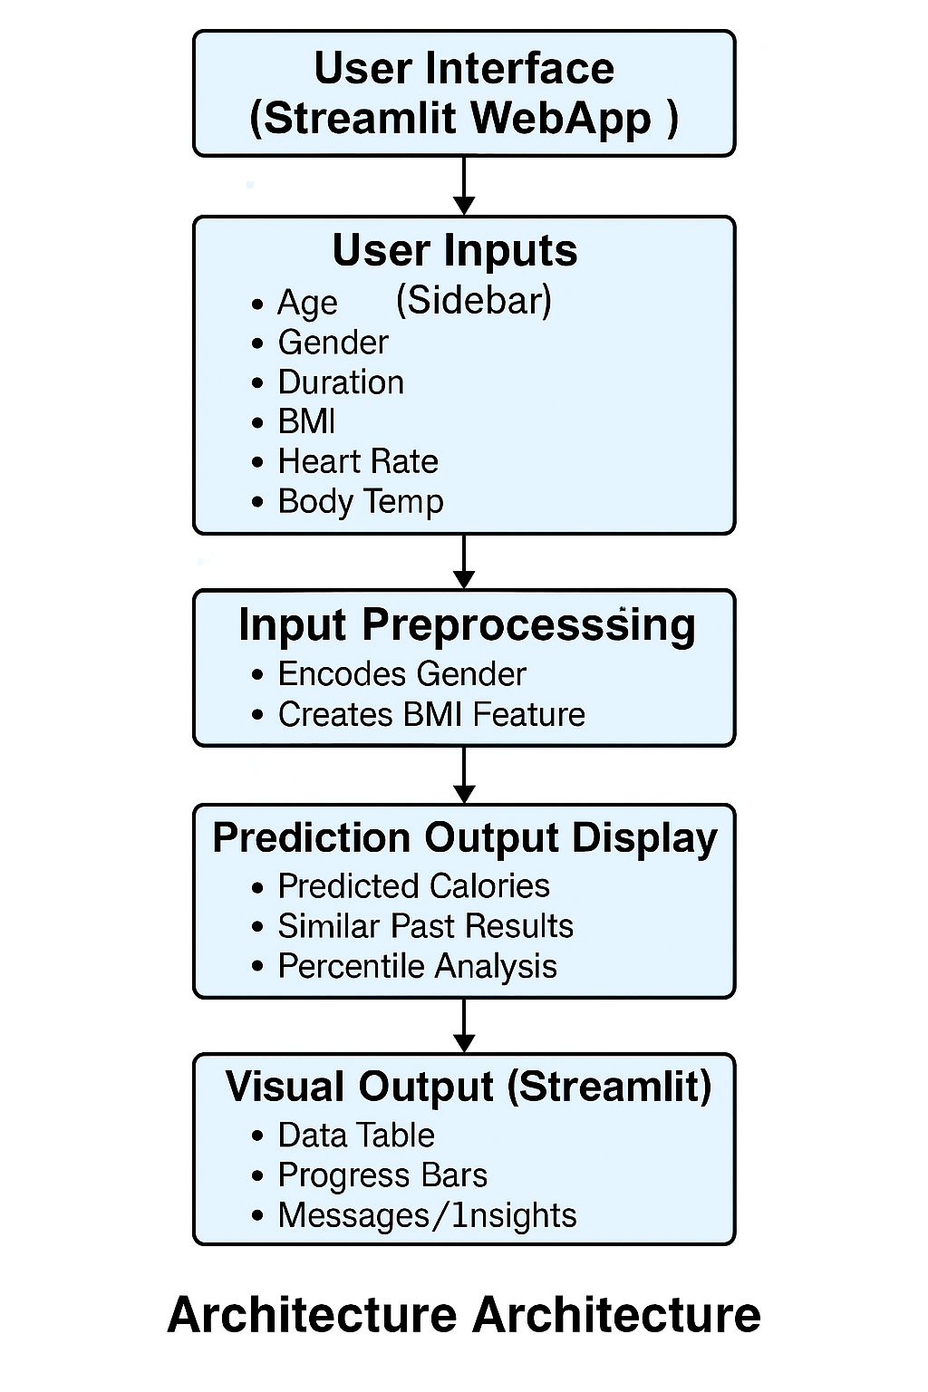
Architecture diagram

Slide 9
Modules
Module | Purpose | Install Command
streamlit | Web app framework | pip install streamlit
numpy | Numerical calculations | pip install numpy
pandas | Data manipulation and DataFrames | pip install pandas
matplotlib | Plotting and visualizations (used via style.use("seaborn")) | pip install matplotlib
seaborn | Enhanced statistical plotting style | pip install seaborn
scikit-learn | Machine learning models and metrics | pip install scikit-learn

Slide 10
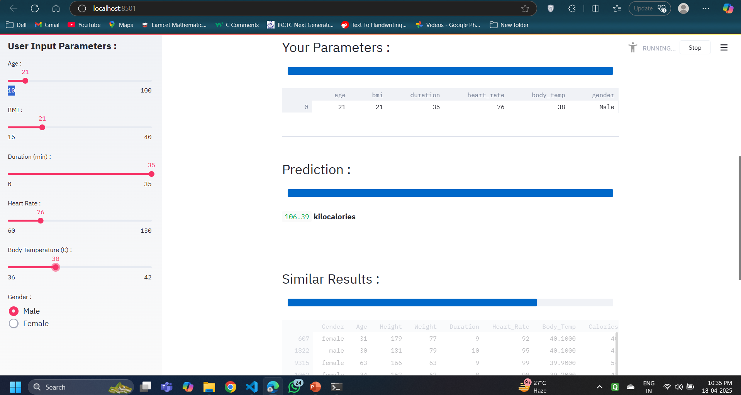
Out put :

Slide 11
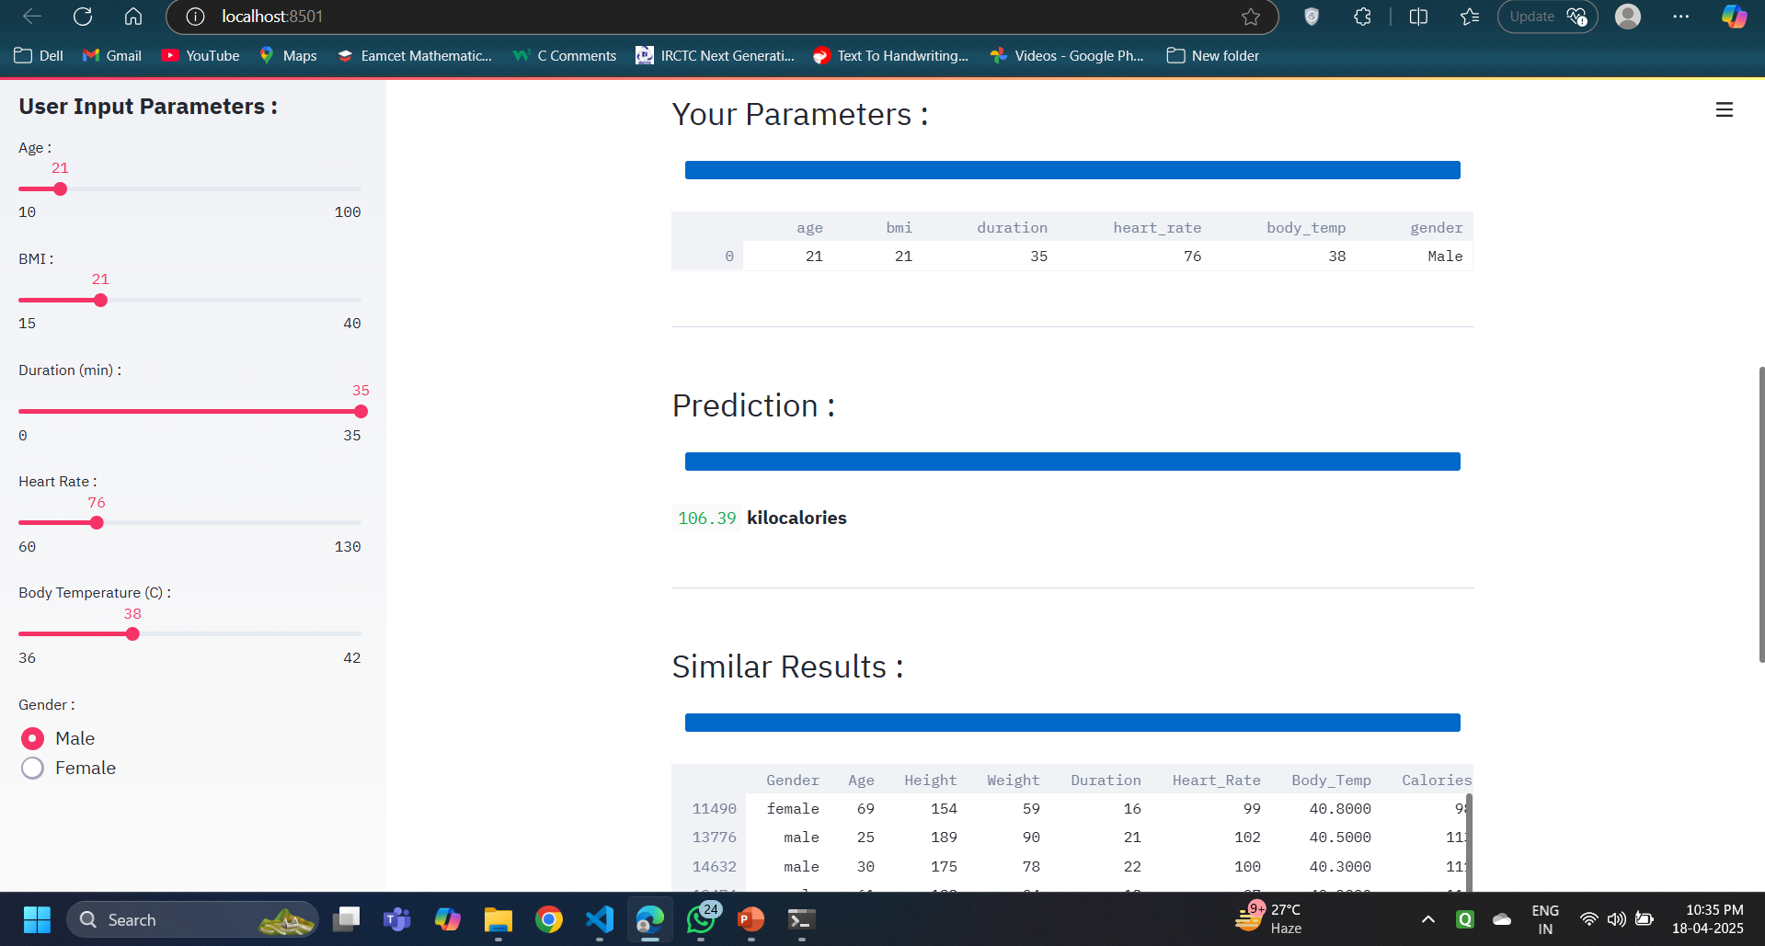

Slide 12
APPLICATION
FOOD RECOGNITION SYSTEM
MULTI MODEL SYSTEM
FITNESS TRACKING
STEP MINT
CALORIES CALCULATION
Gym/Trainer Client Dashboard
Virtual Health Coach

Slide 13
FUTURE SCOPE:
Despite the promising results, the study had limitations, such as a small dataset size and
potential overfitting. Future research could focus on expanding the dataset, refining the
model to prevent overfitting, and exploring other feature selection methods to further
enhance model performance. Additionally, the application of these models across a broader
range of activities and individuals could provide more generalizable results, improving the real
-world applicability of the predictions.
Integrate user authentication to store historical calorie data.
Expand to real-time predictions using fitness tracker APIs
Enhance UI/UX and host the Streamlit app online..

Slide 14
CONCLUSION:
This study aimed to develop an accurate machine learning model for predicting outcomes based
on various characteristics. The random forest regressor model outperformed others in accuracy and key metrics, making it a valuable tool for similar predictions. Feature selection highlighted
key factors important for predicting the target variable, providing valuable insights for the problem domain.

Slide 15
Thank you

